Slide 1

Supporting your child with Phonics and Early Reading in Reception
Part 1 – information about how we teach phonics
Part 2 – information about how we teach reading

Slide 2


The journey to independent reading and writing begins with Phonics.
At Edward Wilson Primary School we teach Phonics using a new highly regarded Phonics scheme called Little Wandle Letters and Sounds.
www.littlewandlelettersandsounds.org.uk
Notes:
Government changes mean a change (for the better) in how we teach phonics and reading at school - make sure there is consistency throughout
Early reading is the stage where children are learning to become fluent readers through the use of phonics

Slide 3
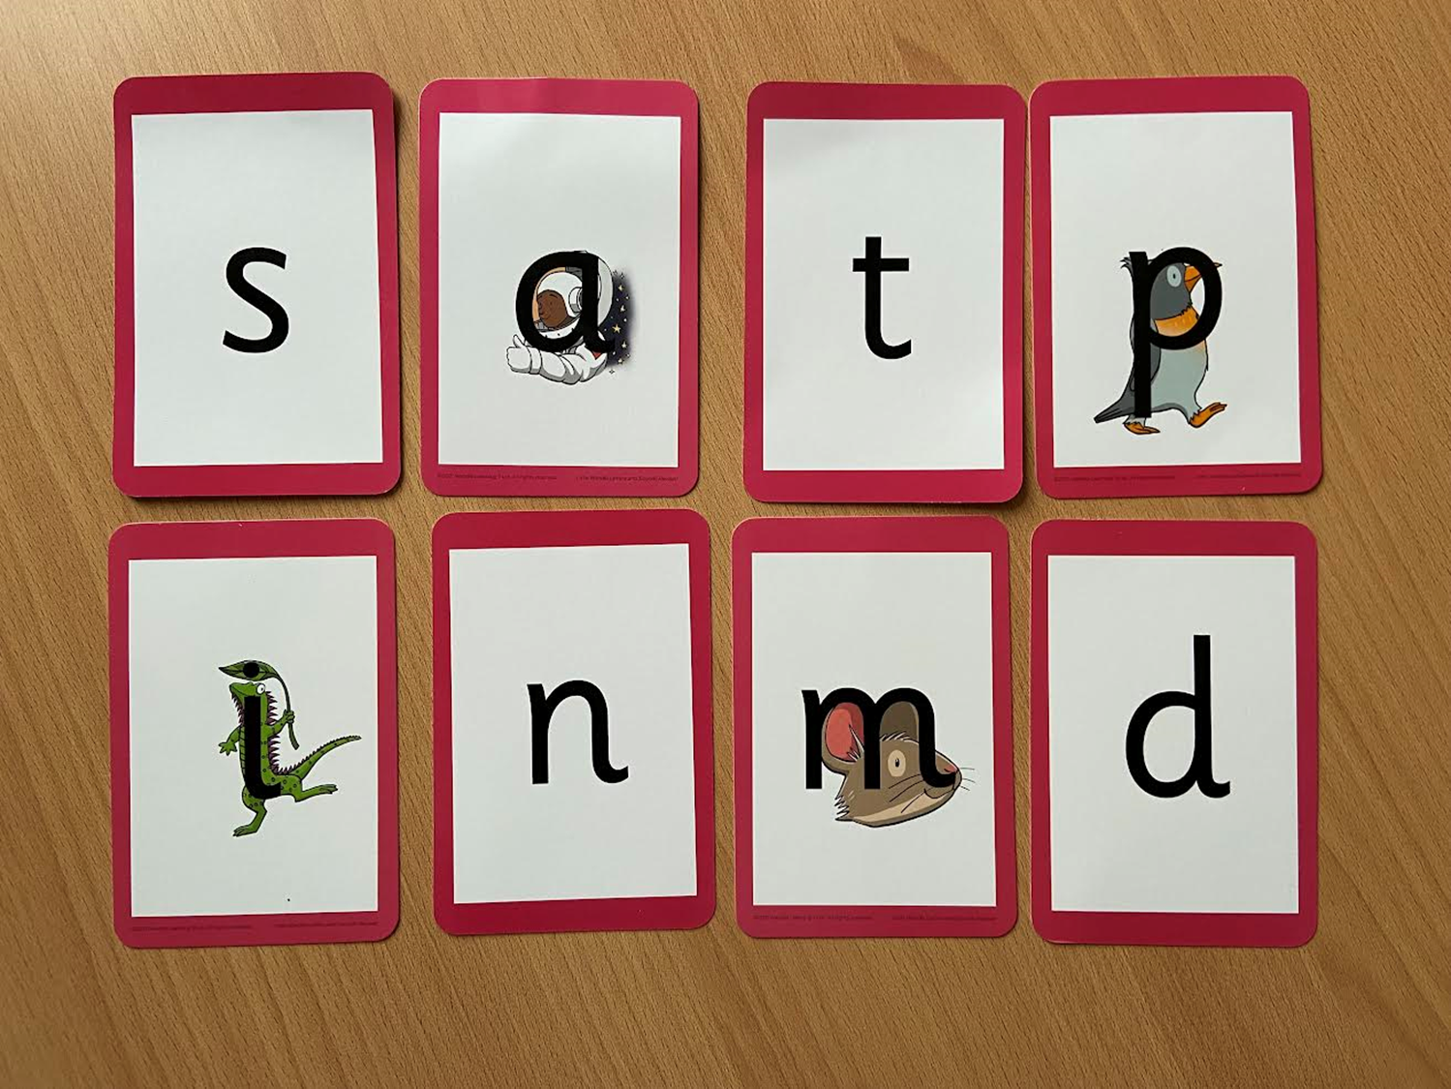
How we teach phonics in Reception
Phonics lesson every day
Revisit and review
Teach and practise
Practise and apply
Lessons involve
lots of repeated
practice
‘Practice makes
permanent’

Slide 4
Blending
sun
‘Sound out’ by saying each letter sound, then blend the sounds together to say the word.
Remember to say the letter sound, NOT the letter name! Say pure sounds, don’t add ‘uh’ on the end.

Slide 5

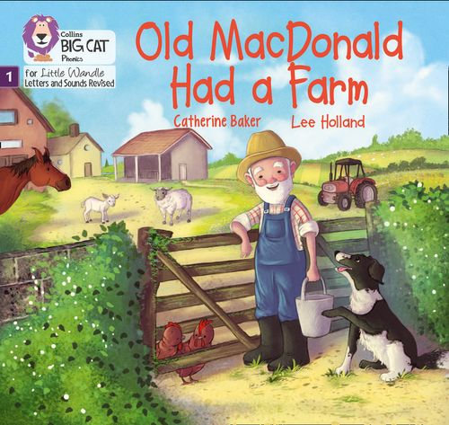
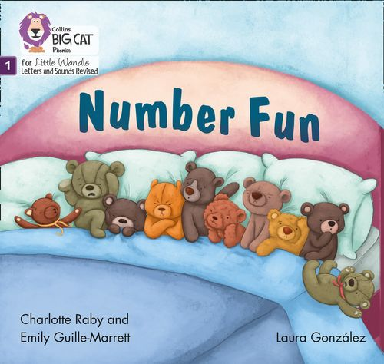
Once children have a secure knowledge of a number of GPCs (Grapheme Phoneme Correspondences) and are confidently blending, they will be ready for
reading books.
Reading lessons start after Autumn half-term in Reception.

Slide 6

Reading
Learning to read should be a positive experience
We want children to
love reading
Reading should be
enjoyable
We want children to read for pleasure
Reading underpins children’s access to the
curriculum and clearly impacts on their achievement
Notes:
We all know how important learning to read is and the impact it has on a childs success - it has to be a positive experience
Whats the reality? Reluctant to read because they find it hard
Frustration stress tears – that’s just the parents
Important to look at the big long term picture

Slide 7
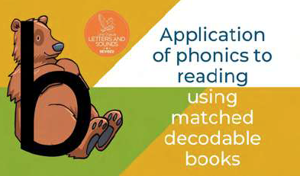

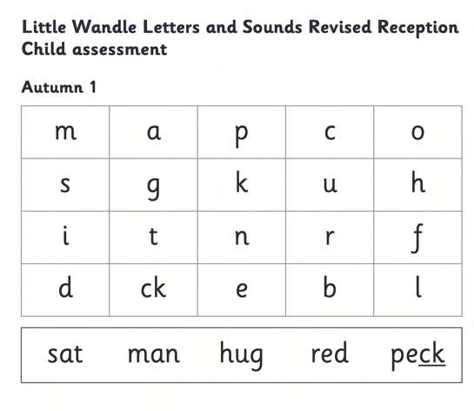




How we teach reading
Reading practice sessions are :
Books are :
matched to children’s
secure phonic knowledge
and word reading
Timetabled 3 times a week
Taught by trained teacher or
teaching assistant
read three times
Taught in small groups
Notes:
Quite a big difference to how reading was previously taught

Slide 8





Big Cat Collins Reading books are carefully matched to children’s secure phonic knowledge
Notes:
To reiterate - Children will not have books containing GPC’s they have not learned and are not secure with
Look at inside cover

Slide 9
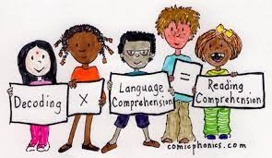
Reading lessons
The Reading lesson books are carefully chosen by the teachers
so children can read them fluently and independently
3 Reads – each one begins with some quick sounds and words
practice
Decoding
Prosody
(intonation, expression)
3. Comprehension
Phonics assessments are done every half-term to ensure that your child is reading books matched to their Phonic knowledge.

Slide 10
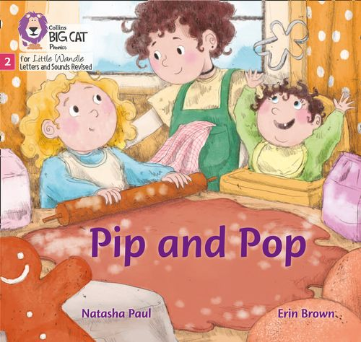

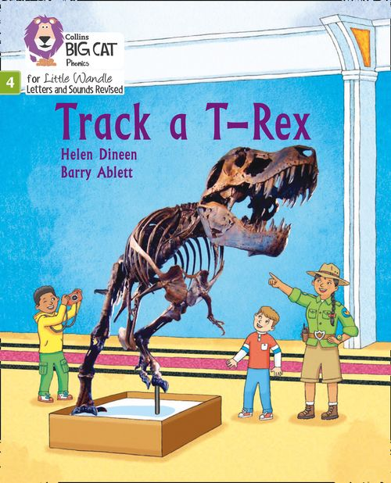
Home Reading
After reading the book in school 3 times, the reading book is sent home so your child can practice reading it at home. Please do not worry that that your child has read the book before– your child needs to develop fluency and confidence in reading.
Re-reading a book they have read before in school helps develop fluency – this is the goal.
Please celebrate their success!!!
Please return all reading books on THURSDAYS.
The Little Wandle reading books will be needed for the next group, so please support us in returning books on the correct day. Keep all reading books in the plastic reading bag to protect them.
New books are sent home on FRIDAYS.
Notes:
Children will not be changing book multiple times a week as previously
Reading groups will be set up so you will be notified of when your book will be sent home/ need to be back in school
Groups will change!

Slide 11




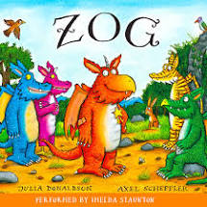
Sharing Book
Children will also bring home a storybook from our book corner each week
To become lifelong readers, it is essential that they read for pleasure
The storybook is for you to read to your child
Please talk about the pictures and enjoy the story or information text together

Slide 12
What else can parents do?
Please attend Friday Family Reading sessions every Friday morning at 8.45am
Please look at the Little Wandle videos and guidance for parents (Google search for ‘Little Wandle’)
Check on the Edward Wilson website
on your child’s class page for documents to support reading and phonics
Check on the Phonics part of the Edward Wilson website (Key information tab)

Slide 13
What else can parents do?
Share books with your children for pleasure
Let your child “show off” their reading to you and celebrate and praise all the way!
Let your child listen to stories on Cbeebies website www.bbc.co.uk/cbeebies/stories
Let your child watch Alphablocks
www.bbc.co.uk/iplayer/episodes/b01cz0p1/alphablocks
Extra Phonics lessons at home on Youtube
www.youtube.com/channel/UCP_FbjYUP_UtldV2K_-niWw/videos
Visit the library and borrow books

Slide 14
Thank you for joining us!
If you have any questions please ask your child’s teacher.

